Slide 1
DATA ANALYSIS OF NYC CAB SERVICES
Abhinandan Dubey, Raju Khanal, Teja Madiraju

Slide 2
DATA ANALYSIS OF NYC CAB SERVICES
Abhinandan Dubey, Raju Khanal, Teja Madiraju

Slide 3
THE BIG PICTURE & THE PROBLEM
GOAL: Analysing commuting patterns in urban communities.
PURPOSE: Extract useful insights from NYC cab system datasets.
KEY INDICATORS: Some key factors that contribute to gaining these insights are
Affluence of neighborhoods.
Tipping patterns.
Distances and routes.
Spatio-temporal dependencies (Locations vs Times of the year)

Slide 4
WHY SHOULD YOU CARE?
Key ideas involve large groups of people.
Any solutions obtained can be mapped to other large cities.

Slide 5
WHY SHOULD YOU CARE?
Key ideas involve large groups of people.
Any solutions obtained can be mapped to other large cities.
241 million | 6 hrs 18 min
Based on a ranking of states with the longest average commute-to-work times, the ACS showed that New York residents spent the most time traveling to their jobs The US Bureau of Labor Statistics estimates that nearly 241 million passengers use NYC cabs annually.
Notes:
Any new place you land up first thing you’ll need is a taxi

Slide 6
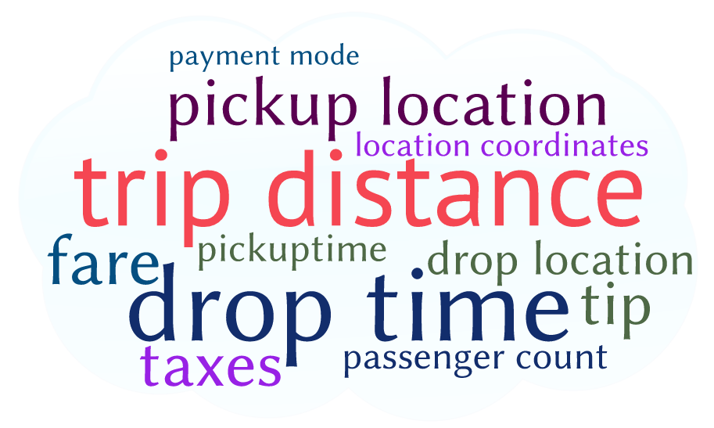
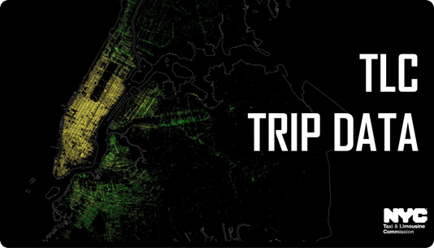
DATA DESCRIPTION
19 Features : 2009 - 2016* across YellowCabs Service
Using Datasets from 2013 - 16* : 1.8 x 42 = 75.6 GB
Dataset: Monthly trip data from TLC, NYC
Features from the dataset
Notes:
* only for spring This may be a popular idea but we believe that the data set is large enough for us to explore interesting problems with a slightly different angle to them.

Slide 7


OBSERVATIONS / EXPERIMENTS
Do disputed payments indicate something about the neighborhood ?
How does the tipping rate change according to location and/or peak times ?
What are the Frequent Pick-up Drop-off points and how they relate to specific times of a year ?
Do people travel in groups during festive seasons ?

Slide 8
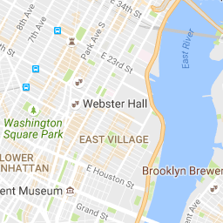
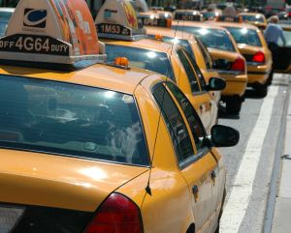
OBSERVATIONS / EXPERIMENTS
Do people in affluent neighborhoods really tip higher (or are they meagre ?)
How much should you tip given a ride / location ?
By how much will taxi fares increase in the subsequent year ?
Notes:
* only for spring

Slide 9
METHODS
Do people in affluent neighborhoods really tip higher ?
Filtered rides with fares > $150 (approx.)
Computed tip per mile grouped by boroughs
Compared with affluency of neighborhoods.
Notes:
5

Slide 10
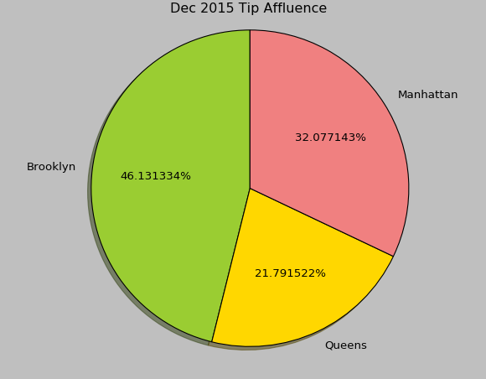
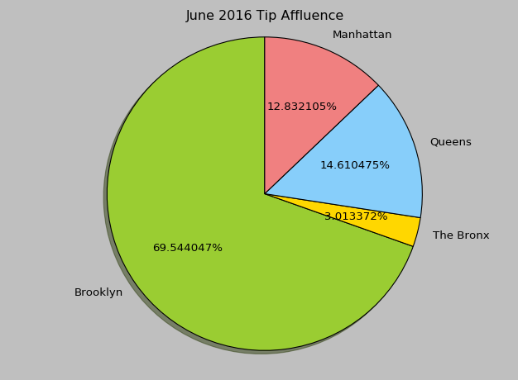
RESULTS
Notes:
5

Slide 11
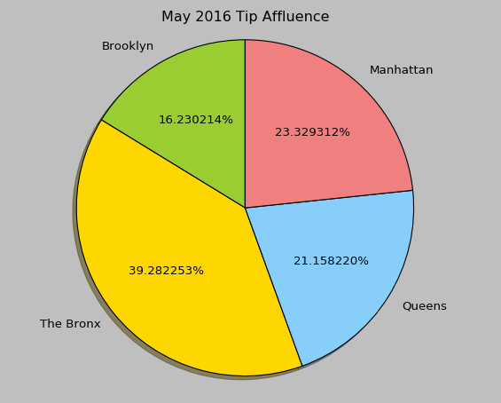
RESULTS
Notes:
5

Slide 12
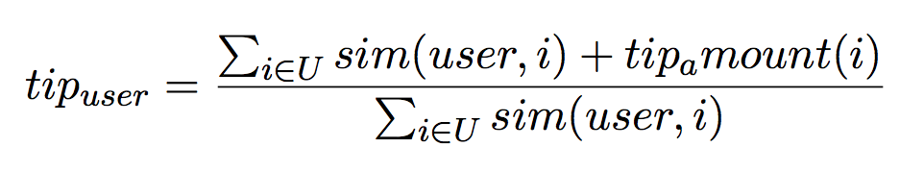
METHODS
How much should you tip given a ride / location ?
Performed user-user collaborative filtering
(Pickup, Drop) = User
Overall Fare = Item
Tip for ride = Rating
Notes:
6

Slide 13
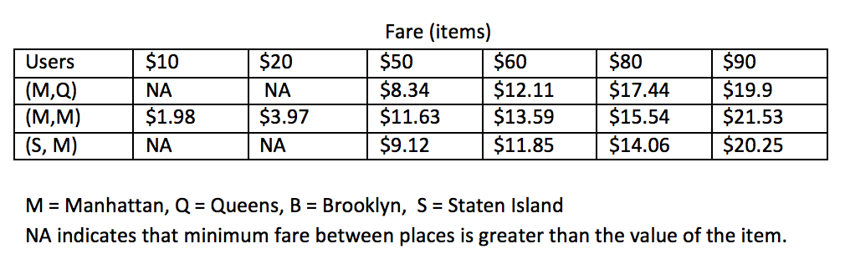
RESULTS
How much should you tip given a ride / location ?
Average tip is ~ 20% of the fare amount.
Cab rides of longer durations result in higher tips.
Shorter distances result in lesser tip amounts.
Some sample recommendations
Notes:
6

Slide 14
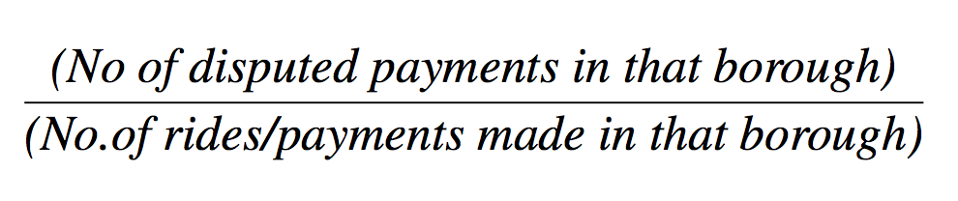
METHODS
Do disputed payments indicate something about the neighborhood?
Notes:
1

Slide 15
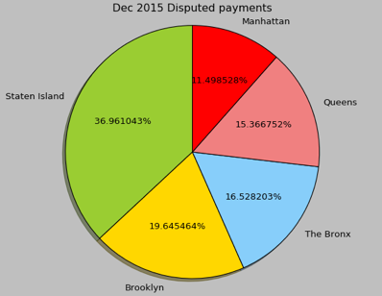
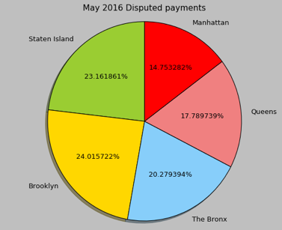
RESULTS
Notes:
1

Slide 16
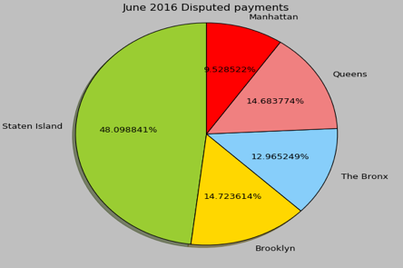
RESULTS
Notes:
1

Slide 17
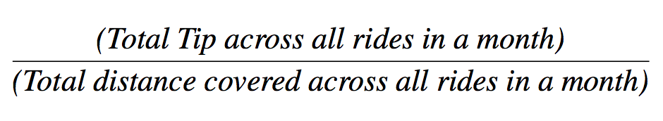
METHODS
How does the tipping rate change according to location and/or peak times ?
Notes:
2

Slide 18
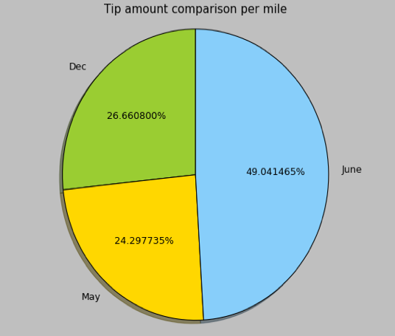
RESULTS
How does the tipping rate change according to location and/or peak times ?
Notes:
2

Slide 19
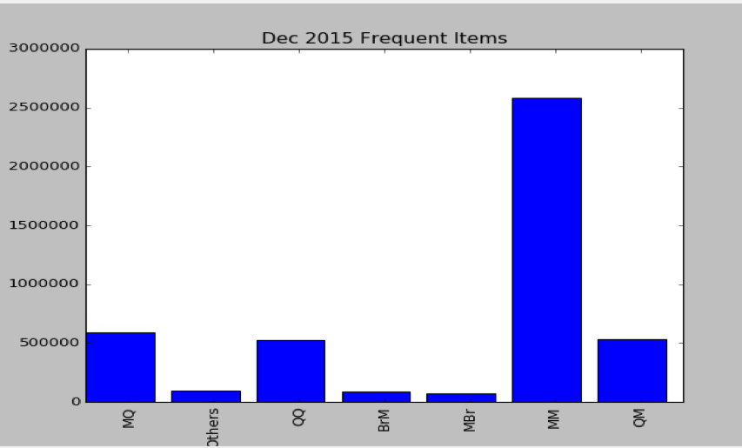
METHODS / RESULTS
What are the Frequent Pick-up Drop-off points and how they relate to specific times of a year ?
FREQUENT ITEMSETS
Notes:
3

Slide 20
METHODS
Do People Travel In Groups During Festive Seasons ?
Approach 1 : Averaging
Approach 2 : k-passenger (k > 1) rides
Notes:
4

Slide 21

RESULTS
Do People Travel In Groups During Festive Seasons ?
Festive Time - Christmas
0.49%
3.88 % higher during these holidays.
Notes:
4

Slide 22
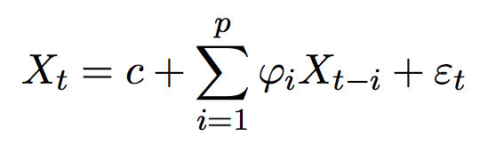
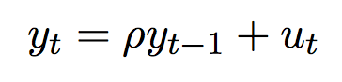

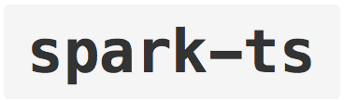

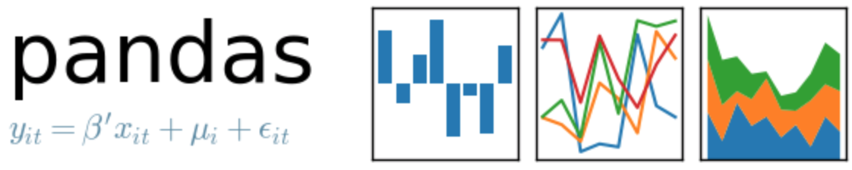
METHODS
How much do you end up paying more for the fare because of traffic, and does it have a specific pattern of increasing over the years?
Notes:
7

Slide 23
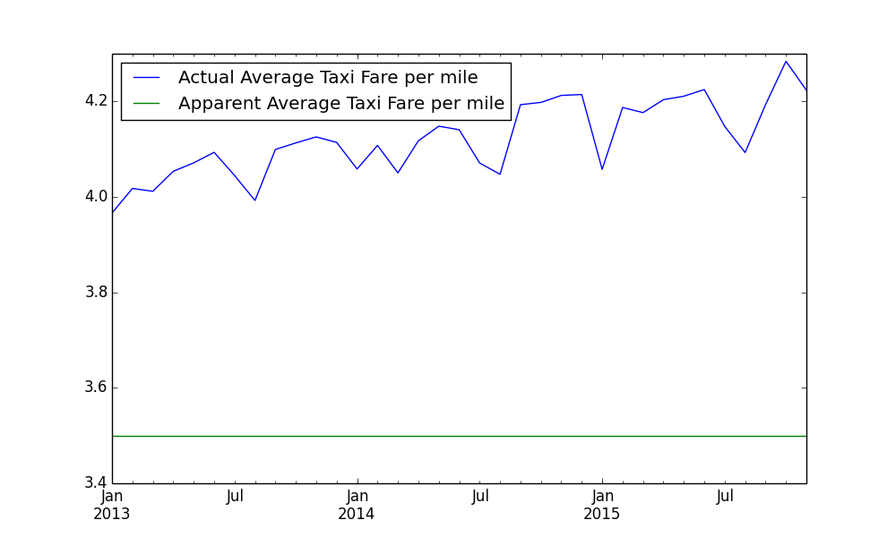
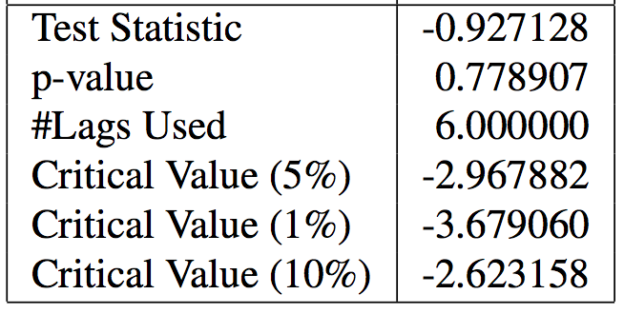
RESULTS
How much do you end up paying more for the fare because of traffic, and does it have a specific pattern of increasing over the years?
Notes:
7

Slide 24
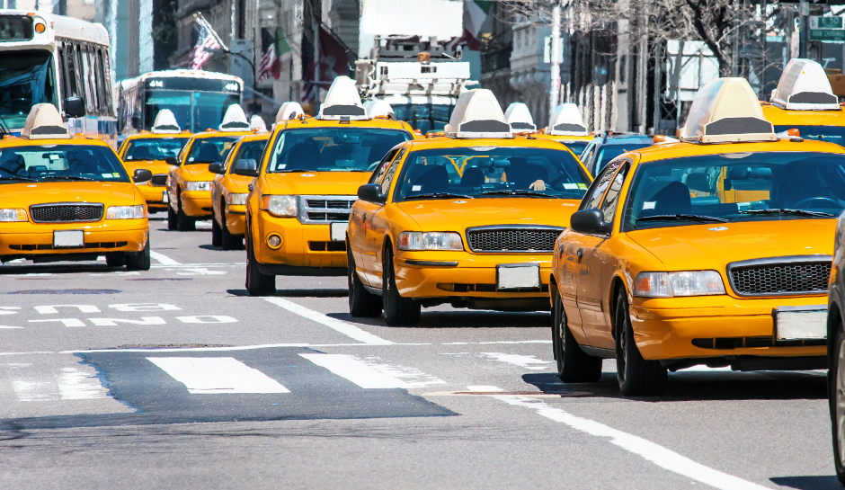
DISCUSSION
Urban communities and their commuting patterns.
Increasing average trip times
Tipping Patterns
Notes:
* only for spring

Slide 25
CONCLUSION
Some benefits include
PASSENGERS: How much to tip for a ride?
CAB DRIVERS: Locality selection with frequent itemsets.
CITY TRANSPORT AUTHORITY: Infrastructure planning, (Increasing Trend for fares due to traffic)
Notes:
* only for spring

Slide 26
THANK YOU
http://www.nyc.gov/html/tlc/html/about/trip_record_data.shtml
NYC Economic Brief - Office of the NYC Comptroller
US Bureau of Labor Statistics - NYC Cab Statistics

Slide 27
Hate Trackers
Tim Vercruysse, Conor Kelton, Parth Dandiwala

Slide 28

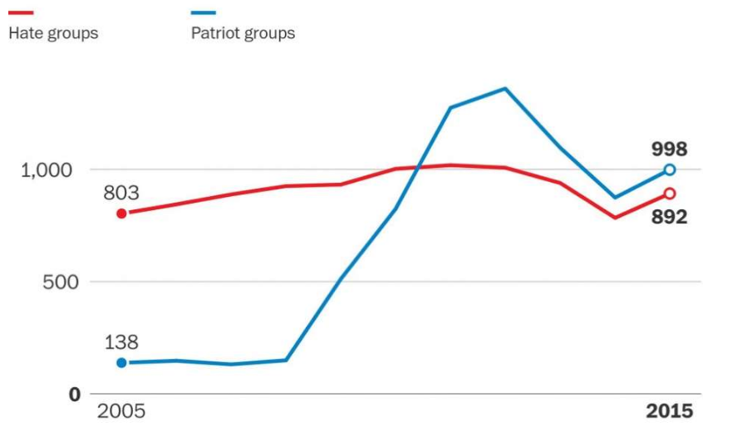
Background & Motivation
‘Year of Enormous Rage’
Article published by Washington Post in February, 2016
14% rise in Hate Groups in 2015 (first increase since 2010)
FBI Reports rise in Anti-Muslim Hate Crimes
100% increase in both KKK chapters and Black Separatist Movements in 2015
Southern Poverty Law Center (SPLC) reports: “[These counts] were likely an underestimate, as extremists increasingly turn to the Internet to congregate anonymously”
Critics Suggest the Opposite: “A broad definition of ‘hate’ leads the SPLC to cast too wide a net, unfairly ensnaring groups simply for having strong conservative views”
What is Hate Speech on the Web?
Is it truly increasing over time?
Notes:
Conor

Slide 29


Approach and Data Description
+
Our Approach to Exploring Hate Speech on the Web:
Obtain standard Hate Speech corpus
Obtain Website text to determine feature representation of a Hate Speech paragraph
Learn a ‘Hate Speech Paragraph’ classifier based on weakly supervised Website text using Hate Speech corpus
Identify a site as a ‘Hate Site’ from its classified ‘Hate Speech Paragraphs’
Data Sources Needed
Hate Speech corpus -> www.hatebase.org
Website Text -> Common Crawl WET Base (Feb 2016 and Sep 2016), ~20TB
Notes:
Conor

Slide 30
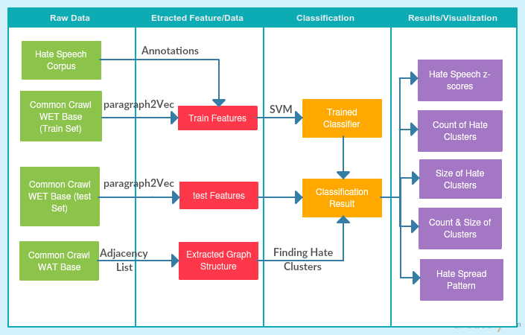
Proposed Methodology:
Notes:
Parth

Slide 31
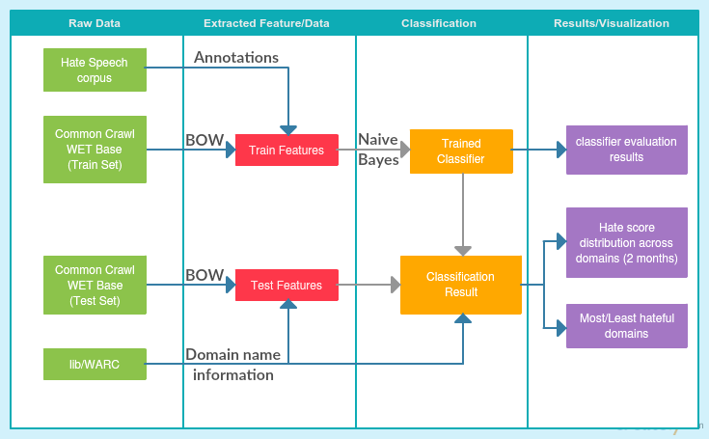
Implemented Methodology:
Notes:
Parth

Slide 32
Teamwork
Initial project scoping, method selection and analysis was collaborative
Feature Extraction - Conor
Classifier Training - Parth
Bulk Classification and Trend Analysis - Tim
Analysis & Conclusion - All
Notes:
Parth

Slide 33
Methods - Training Samples
And Weak Labeling
Sample Selection
Training samples selected from a subset of the September 2016 Common Crawl
Training samples weakly labeled based on presence of words from Hatebase.org corpus that contained a hatefullness score (309 total)
This rule based labeling and selection known as a high precision classifier
2 sample sets extracted: 11k and 550k, overall only about 100 hate paragraphs per 25MB of CC WET data so 1:10 hate to non-hate sample ratio. (<5MB vs 150MB)
Notes:
Conor

Slide 34
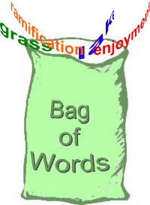
Methods - Feature Extraction
And Binary Bag of Words
Feature Extraction
Binary BoW used (MlLib CountVectorizer) from top word/2gram/3gram frequencies
Features = Binary presence of learned word in paragraph
Extracted directly from weakly labeled data
3 Models used, 11k features for the 11k samples (n = p) and 55k and 550k features for the 550k samples (n = .1p and n = p)
Notes:
Conor

Slide 35
Methods - Training Classifier
We trained 3 different classifiers:
Naive Bayes Classifier
Logistic Regression Classifier
Random Forest Classifier
For each classifier following steps were taken:
Get a train:test split of 9:1 ratio from the training data
Perform grid search on with 5-Fold cross validation to choose the best hyperparameters
Get the best classifier and evaluate on the test set
Classifiers trained on each sample x feature set to find best performance:size ratio.
Notes:
Parth

Slide 36
Methods - Classifying Web & Performing Analysis
For classifying the web and getting per domain data, the following steps were taken for each month:
Took 10% uniform random sample of WET files
For each paragraph in each domain:
Extract 1-, 2-, and 3-grams and thus features from learned feature model
Classify each paragraph using learned classifier
Calculate non-standardized score for each domain (# hate paragraphs / total paragraphs)
Perform standardization of scores to compare across months
Compute mean and standard deviation of the z-scores
Notes:
Parth

Slide 37
Results - Feature extraction model
We performed empirical evaluation of the BoW model and following was noted:
In addition new words/phrases were learned by the model
Ex. from top 100 freq words/n-grams: ‘kill’, ‘united states’, ‘obama’, etc)
Samples suggest success of initial rule based sample selection and labeling (i.e. model is potentially learning true hate speech)
Notes:
Conor

Slide 38
Discussion - Feature Extraction Method
Why Binary BoW?
No pretrained par2vec with hatebase vocabulary, only 6 of our ‘high precision hate words’ contained within Stanford GloVe (a par2vec on the Common Crawl)
Smaller model for broadcasting, 5.2GB for Stanford GloVe par2vec on Common Crawl, 81.5KB Apache Parquet for our CountVectorizer BoW Model
BoW performance shown to rival par2vec approaches for semantic analysis (see Related Work in paper for details)
Notes:
Conor

Slide 39
Results - Classifier
Hyperparameters used in grid search
Classifier | Hyperparameters (grid search)
Naive Bayes | Laplace smoothing constant: [0, 1, 2, 5, 10, 20]
Logistic regression | regParam: [10, 1, 0.1, 0.01, 0.001, 0.0001]
Random Forest | Number of trees: [5, 10, 20, 25] Depth of trees: [2, 5, 10, 20]
Classifier evaluation results (on test set)
Classifier | 11K | 55K | 550K
Naive Bayes | 0.955 | 0.954 | 0.959
Logistic Regression | 0.938 | 0.937 | 0.945
Random Forest | 0.963 | 0.951 | -
Notes:
Parth

Slide 40
Discussion - Training Classifier
Dataframe Vs RDD
Dataframe: Designed for immutable data and better parallel performance
RDD: Good for low level transformations
pyspark.ml Vs pyspark.mllib
pyspark.ml: Provides Dataframe Api
pyspark.ml: Works well with pyspark.tuning and thus grird search, cross validation and evaluation becomes easier
Pyspark.ml: Provides a wider range of algorithms but most of them are RDD based
Why Naive Bayes?
Size: Smaller size and smaller memory consumption (NB: ~30K, LR: ~90K and RF: ~250K)
Computational Cost: Training cost is lowest for NB
Performance: The improvement in performance of RF compared to NB is insignificant.
Notes:
Parth

Slide 41
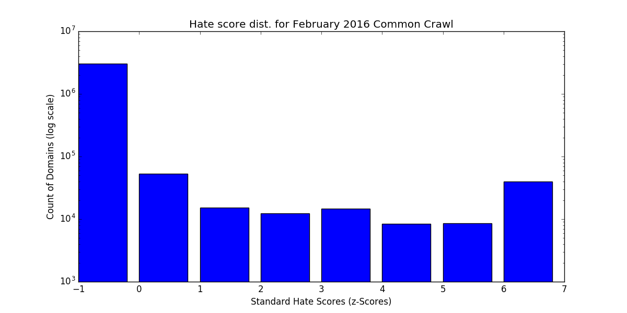
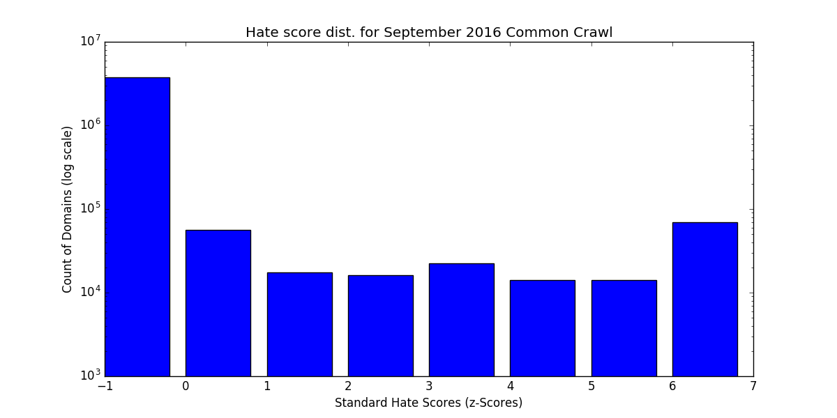
Results - Hate across domains
Domain distribution (Log scale) for Feb. 2016
Domain distribution (Log scale) for Sep. 2016
Mean z-score: -0.025168
% of Hate Sites with z-score >= 6: 1.25%
Mean z-score: 0.0202024
% of Hate Sites with z-score >= 6: 1.74%
Notes:
Tim

Slide 42
Discussion - Bulk Classification Labeling
Our resulting hateful domains:
Mostly Pornographical sites and some suprious Dutch sites
Why Dutch-language sites?
Possibly due to language mismatches between hate words and web sites
Word used in one language may be hateful, but in another is normal/common
Future Approach: Need to manually annotate resulting Common Crawl samples selected with all potential Hatebase.org identifier words
Also: Bootstrapping (running multiple classification into BoW learning iterations)
Some examples of least hateful domains (Assorted random innocuous websites)
Themoneyconverter.com
Cheesepie.com
healthguru.com
Notes:
Tim

Slide 43
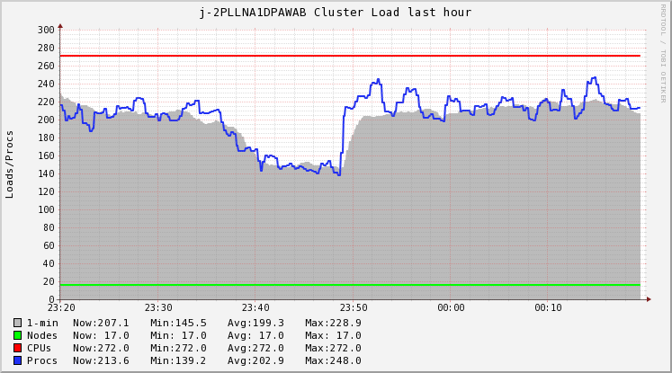
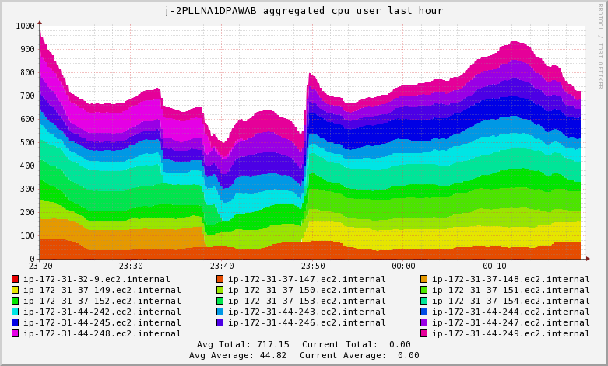
Discussion - Implementation of Bulk Classification
Bulk Classification of the Common Crawl is a major challenge
Sampling 10% of 2 crawls required 30 hours of processing with the following configuration:
Amazon EMR with 16 mx.4xlarge instances (16 CPU cores, 64GB RAM each) totaling 256 CPU cores and 1024GB RAM in the cluster.
The operation was network and CPU intensive: feature extraction, classifier computation
Why no link analysis? -> Formatting of Crawl not consistent between WET and WAT! (full search required for formal classification + link analysis, can’t match up directly)
Notes:
Tim

Slide 44
Conclusion & Future work
Showed an increase in mean hate score from -0.025168 to 0.02020
Future Work:
Full bootstrapping process (more iterations)
Better selection of hate works for initial weak labeling
Language sensitivity (only use hate words of a specific language to weakly label text in that same language)
Use larger cluster for a longer time to achieve full analysis of crawls
Link Analysis to determine hate clustering and spread
Notes:
Tim

Slide 45
Trend and opinion mining from Twitter
0ut1ier: Meng-Chieh Yang Yi Tong Jiayao Zhang

Slide 46

Motivation
Sometimes, big picture only gives dominant idea.
It cannot represent opinions around your area.
Want to know local reactions about trendy issues.
Why Twitter?
- 500 million tweets/ day (big data)
- 300 million active users
- Temporal property
- Tweets contain sentimental sentences.
- Easy access (Twitter API)

Slide 47
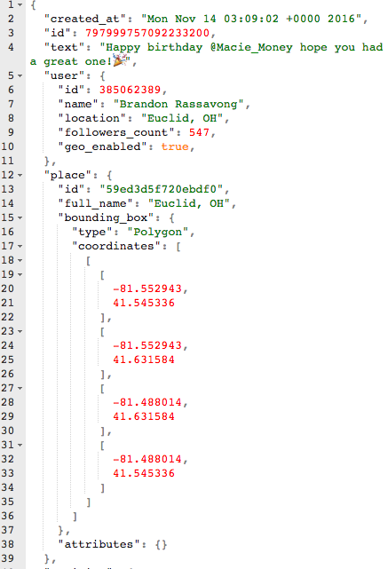
Data Description
Streaming from twitter API
Rate:
no more than 1% of total tweets at the moment
Format: JSON
Contains many fields:
message body, user profile, coordinates, retweet, etc.
Training Data:
From sentiment140
1.6 million tweets and sentiments
In format: “sentiment”,”id”,”time”,”tweets”

Slide 48

Methods
Data Scraping
Stream Clustering
Twitter stream data
Find Local Trends
Sentiment Analysis
Visualization

Slide 49
Methods
Train Sentiment Analysis Model
Spark Session
regexp_replace
Tokenizer
StopWords
Remover
Load Dataset as Data Frame
Replace all kind of spaces and URLs with " "
Tokenize
Remove Stopwords
Train Random Forest Classifier Model
Split Training Data to training set and test set by 7:3
Convert String Label to Index
Convert Tokens to Vectors
RandomForest
Classifier
randomSplit
String
Indexer
Word2Vec

Slide 50
Methods
Twitter Streaming And Processing
apps.
twitter.com
StreamingContext.
socketTextStream
Pipeline
Model.load
Streaming
KMeans
Setup Twitter Streaming API
Connect to streaming API
Load sentiment analysis model
Cluster by location
Leaflet.js Interactive Map
Visualization
Send to sentiment analysis model
Find Trend for Each Cluster (depend on cluster size)
AJAX load data
Python flask backend
Model.
transform
Count hashtag

Slide 51
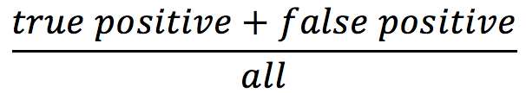
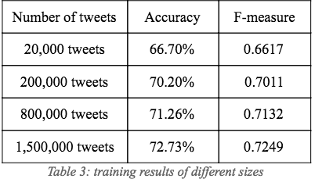
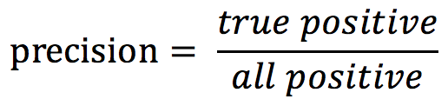
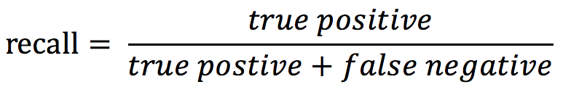
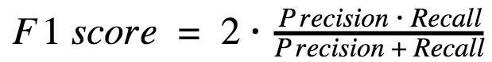
Results / Evaluation
Accuracy
F-measure
Sentiment Analysis

Slide 52
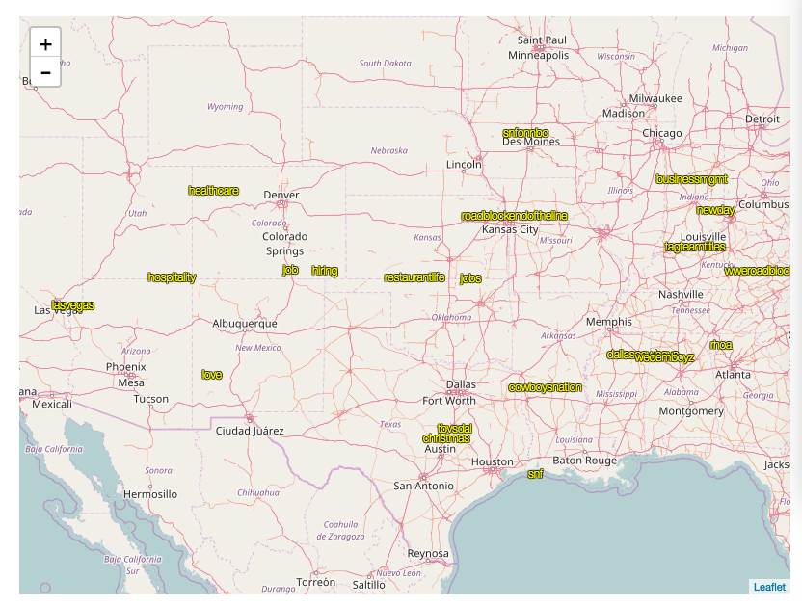
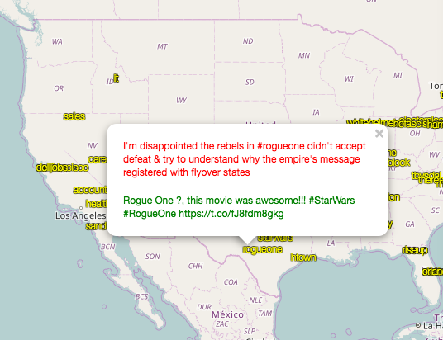
Visualization of trend
Web app that shows a map
Display the trend keywords in real-time
Load content(tweets) on keyword click
Show sentiment with color
Observations:
Most popular keywords: jobs, hiring, holiday, snow etc.
A lot of ads

Slide 53
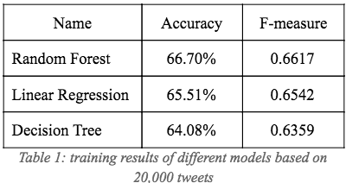
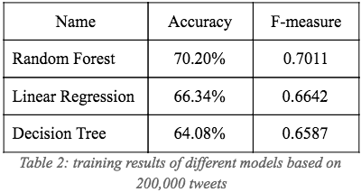
Discussion
Comparison between models
Difficulties
Training time of Random Forest Model takes 40 minutes
Memory limitation:
can’t set tree number too large
Long time for shuffling and failed in the long run

Slide 54
Conclusion
Used spark streaming to process real-time data
Cluster by location and extracted real-time trends
Predicted sentiment of tweets
Visualized result on a map for easier trend discovery

Slide 55
References
https://anirudhbhatnagar.com/2013/05/08/using-map-reduce-to-find-the-twitter-trends/
http://nlp.stanford.edu/sentiment/index.html
http://help.sentiment140.com/for-students
http://tweenator.com/index.php?page_id=13
http://www.sananalytics.com/lab/twitter-sentiment/

Slide 56
Restaurant Recommendation System using Yelp Dataset
Aman Raj Nafisa Mandliwala
Anirudh Perugu Rahool Paliwal

Slide 57
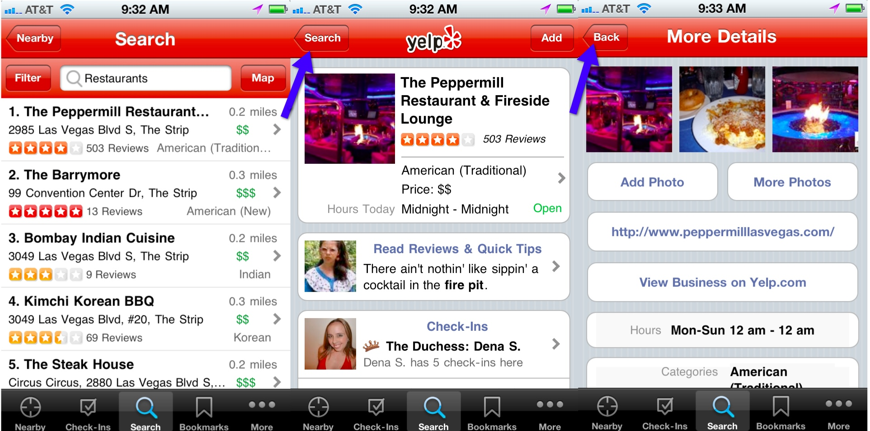
What is Yelp?
Platform for customers to review and rate the services of several businesses.

Slide 58
Problem Definition/Why should people care?
Data
Amount of data has increased tremendously in the recent past.
Big Data techniques allow us to process large data and gain meaningful insights into it.
What are people looking for?
A personalized user experience.
We built a recommendation system and also explored the data.

Slide 59
Data Description^{[2]}
Restaurant review data for 84k businesses located all over the US by 687k users for over 4 years of data.
Number of Features : 50
Data Content :
Review (~2.7M) → { 'business_id', 'user_id', 'stars', 'text', 'date', 'votes' … }
User (687K) → { 'user_id', 'name', 'review_count', 'average_stars', 'votes', 'friends' ... }
Business (86K) → { 'business_id', 'name', 'neighborhoods', 'full_address', 'city', 'state', 'latitude', 'longitude', 'stars' ... }
Checkin (60K) → { 'business_id', 'checkin_info' ... }

Slide 60
Specific Experiments / Methods
Data Exploration
Bi-gram Word Cloud on Reviews
Geographic Analysis
Popular categories based on multiple business sectors
Recommendation System
Collaborative filtering (Business-Business filtering using ALS)
Clustering
Cluster Businesses on basis of categories.

Slide 61
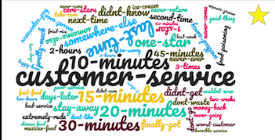
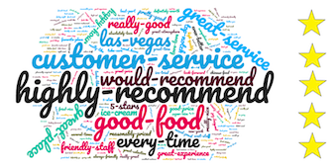
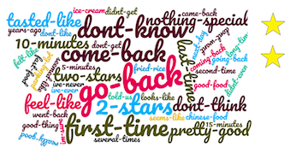
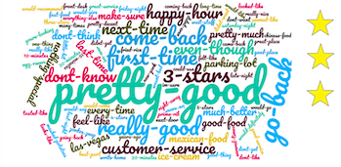
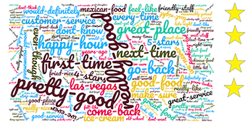
Specific Experiments / Methods
Data Exploration
Word Cloud on Reviews based on Ratings

Slide 62
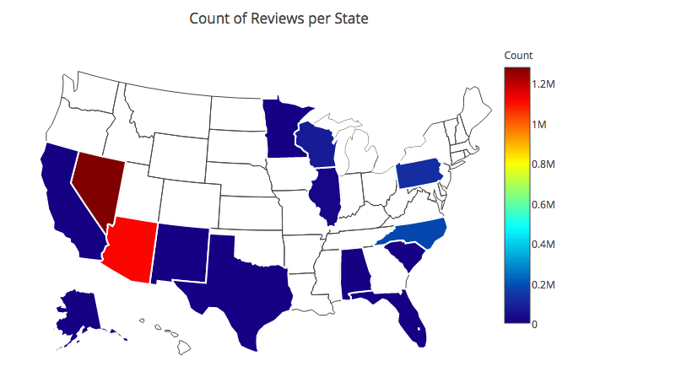
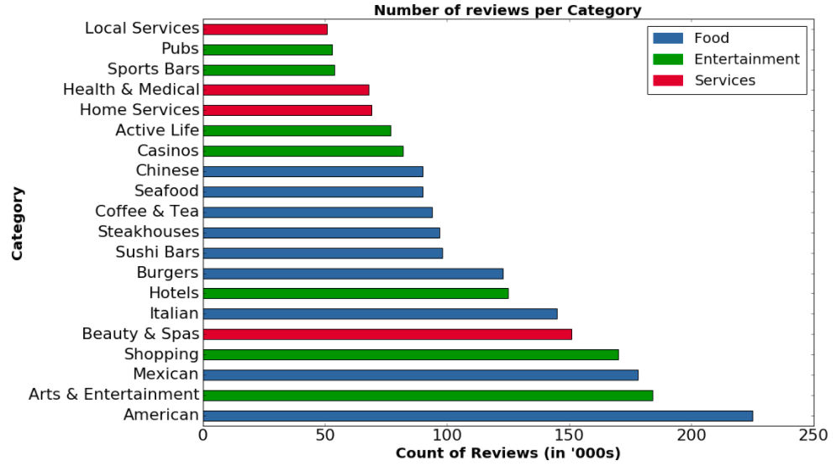
Specific Experiments / Methods
Data Exploration
Geographic Analysis
Popular categories based on multiple business sectors

Slide 63
Specific Experiments / Methods
Recommendation System
Collaborative filtering (item-item based)
Data massaging for collaborative filtering.
Data prediction using spark.
RMSE [80% training, 20% test]
Our recommendation model predicts the user’s rating for a business with 85.6% accuracy.

Slide 64
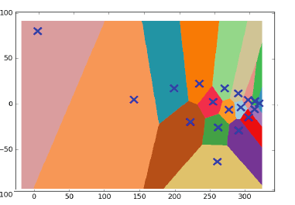
Specific Experiments / Methods
0 | ['Auto Repair', 'Automotive', 'Tires', 'Car Dealers',]
1 | ['Pizza', 'Restaurants', 'Food', 'Ice Cream & Frozen Yogurt', 'Delis', 'Breakfast & Brunch', 'Diners', ..]
2 | ['Professional Services', 'Arts & Entertainment', 'Shopping', 'Video/Film Production', 'Photography Stores & Services', ..]
3 | ['Health & Medical', 'Dentists', 'Orthodontists', 'General Dentistry', 'Cosmetic Dentists', ..]
4 | ['Local Services', 'Preschools', 'Education', 'Child Care & Day Care', 'Elementary Schools', ..]
5 | ['Arts & Entertainment', 'Venues & Event Spaces', 'Parks', 'Active Life', 'Botanical Gardens', 'Event Planning & Services', ..]
Clustering
Cluster Businesses on basis of categories

Slide 65
Results Summary
Data Exploration
Word Cloud
Geographical Analysis
Reviews per category
Recommendation System
Accuracy of 85.6%
RMSE 14.4%
Clustering
18 clusters using elbow method

Slide 66
Team Work
Data massaging - Aman, Anirudh
Data exploration - Aman, Nafisa
Text analysis
Geographical representation
Histogram
Recommendation System - Anirudh, Rahool
Clustering - Anirudh, Nafisa

Slide 67
Conclusion
We thus aim to achieve the following :
We used spark, text analysis, K-means clustering, dimensionality reduction, collaborative filtering.
Data explorations to gain insights into data and clustering.
A recommendation engine that recommends restaurants based on the user profile.

Slide 68
References
http://searchengineland.com/why-siri-yelp-google-maps-iphone-4s-96976
https://www.yelp.com/dataset_challenge/

Slide 69
Thank You.

Slide 70
Data Sentinels
Amit Gupta, Adarsh Kashyap, Kanishta Agarwal,
Gayathri Shivakumar

Slide 71

Domain classification and Sentiment analysis of tweets

Slide 72

Big picture Scope
Intention - Classify the domain of the tweet and also understand the sentiment involved in the tweet posted by a user.
Domains that we have considered for this project are Sports and Politics.
Tweets are classified into positive sentiment tweet and negative sentiment tweet.
Sentiment classification is also called opinion mining.
Opinions of the mass has huge value, many companies use this method to understand reaction of people about a product or software that they release to the market.

Slide 73
Motivation
Social media content, like twitter includes rich structured content.
Useful information related to the person communicating, location, tag names are available.
Twitter, platform for people to express opinion about almost every single topic.
About 240+ million active users, almost 500 million tweets generated everyday. Imagine how much of data is available out there!!
Huge scope for application of big data techniques learnt during the course.
Opinion of the mass matters
Opinion of people towards political party
Reviews of products released by a company
Understanding sentiment of people towards a particular type of music.
Notes:
An aspect of social media content such as twitter is that it includes rich structured content and also useful information related to the person communicating.

Slide 74
Data and features
Features :
Since every unique word we get after pre-processing the training data is a feature for the classifier, we had set the feature limit to 10,000 for both the classifiers.
We have used ‘Bloom Filter’ to filter the tweets initially and we have used about 1300+ features to train the bloom filter.
Emoticons are used as a part of the features.
Data :
Training set for emoticons had about 32,50,000 pre classified tweets, which is about 500 MB
Training set for domain had about 3,00,000 tweets.
Tested the domain and sentiment classification on about 500000 tweets which we streamed past two days.

Slide 75




Methods
Training data for sports
Training data for politics
Tweets to classify

Slide 76

Methods cont..

Slide 77

Team work
Tweet streaming – Kanishta Agarwal
Pre-processing and collecting training set – Kanishta Agarwal and Amit Gupta
Bloom filter implementation – Amit Gupta
Naïve Bayes and SVM implementation and analysis – Adarsh , Gayathri
Analysis and output representation – Gayathri
Report and presentations slides – All of us

Slide 78


Results and analysis
Output actually generated by the code
Classification accuracy comparison

Slide 79




Results and analysis cont..

Slide 80


Results and analysis cont..

Slide 81


Results and analysis cont..

Slide 82



Concepts Covered
Stream data analysis : Map Reduce/Spark
Filtering domains(Music/politics) : Bloom filter
Classification of Tweets : Naive Bayes classifier, Support
Vector Machine
Data Streaming

Slide 83

Conclusion
Achieved goal - Understood intricacies of classifiers, filters, data streaming platforms
Domain classification and sentiment - both classifiers performed reasonably well.
Naive Bayes falls behind when less training set, but at par with SVM for very large data.
Outcome of domain classification - Not satisfactory, since words used as filter by bloom filter were ambiguous and not adequate.
Sentiment classification -Satisfactory, owing to the aforementioned constraints.

Slide 84
THANK YOU

Slide 85
Bookworms’ Buddy
Data Buffs: Vijay Teja Gottipati, Varsha Venkatesh, Sadhana Kumaravel

Slide 86
Recommender system for books
...because there are way too many books out there to choose from!
The Data Buffs:
Varsha Venkatesh
Sadhana Kumaravel
Vijay Teja Gottipati

Slide 87


Why should anyone care?
Still rely on word of mouth
Long Tail
Notes:
A recommender could also recommend books that we might not have come across otherwise
A good recommender will need a good amount of data.We were lucky enough to find the Amazon book reviews dataset which consists of

Slide 88

~2 Million Books
~8 Million Users
~22 Million Reviews
~19 GB Data
That calls for big data concepts

Slide 89
Data Description - Amazon Books Review dataset
{ "reviewerID": "A2SUAM1J3GNN3B", "asin": "0000013714", "reviewerName": "J. McDonald", "helpful": [2, 3], "reviewText": "This book is Amazing", "overall": 5.0, "summary": "Heavenly Highway Hymns", "unixReviewTime": 1252800000, "reviewTime": "09 13, 2009" }
Notes:
And other attributes

Slide 90
Methods
Baselines
Weak - Global mean
Strong - Account for User and Item biases

Slide 91
Methods
Content based using
Review text
Book description
Notes:
In order to do this, we create a book profile consisting of features extracted from its reviews as well as a user profile which is a combination of user rated book profiles.
For every user-book pair we generate a score based on similarity
In order to better understand the trade offs between the different approaches we want to perform experiments such as:

Slide 92
Content based
Would the recommender perform better when content from the item is utilized?

Slide 93

Content based pipeline
Image source : https://buildingrecommenders.wordpress.com/2015/11/18/overview-of-recommender-algorithms-part-2/

Slide 94






Construction of features
http://beforeitsnews.com/mediadrop/uploads/2013/38/b196ad96079ab9057d45137edcfe81561cc477ce.jpg
http://combiboilersleeds.com/keywords/words-1.html
http://brandonrose.org/clustering
https://www.vectorstock.com/royalty-free-vector/compress-arrows-stroke-icon-vector-8264419

Slide 95
Construction of item-item similarity matrix
All pair similarity matrix is huge,similarity join scales quadratically
An efficient method called Dimension Independent Matrix Square using MapReduce or DIMSUM is used to calculate similarity
sampling technique to focus the computational effort on those pairs that are above the similarity threshold
Notes:
The brute force approach of considering all pairs quickly breaks, since it scales quadratically.

Slide 96

Content based pipeline
Notes:
In order to do this, we create a book profile consisting of features extracted from its reviews as well as a user profile which is a combination of user rated book profiles.
For every user-book pair we generate a score based on similarity
In order to better understand the trade offs between the different approaches we want to perform experiments such as:

Slide 97
Content based
But wait...Descriptions of the books are a better source of content than reviews !
They capture the characteristics of the book more than what reviews do as reviews can be biased.

Slide 98

Methods
Collaborative Filtering
Latent model
Normalized
latent model

Slide 99

Latent factor model
Image source : https://buildingrecommenders.wordpress.com/2015/11/18/overview-of-recommender-algorithms-part-2/

Slide 100

Latent factor model

Slide 101
Matrix factorization - ALS
An approach to MF
Alternate fixing one matrix
Faster compared to SGD
Scalability through parallelization
Available in library

Slide 102
Latent model implementation
Split training:dev:test in 7:1:2 ratio
ALS Hyper parameters:
Rank: 5, 15, 25
Lambda: 0.1, 1.0, 10.0
Iterations: 20

Slide 103
Results
Approach | RMSE | RMSE on Top-K
Weak baseline | 1.05696867646 | 1.048871098
Strong Baseline | 0.823506157962 | 0.816363691418
Latent model | 0.63816158407 | 0.64880636174
Normalized latent model | 0.584179690705 | 0.576482777052
Content-based: review text | 0.482570349722 | 0.482369729873
Content-based: description | 0.686800949854 | 0.646781840788

Slide 104
Discussion
More to rating than user and item biases
Normalization pronounces effect
Using review text is cheating
Potential for better features
Notes:
Cheating because of 2 reasons:
It does not solve cold start problem because features are extracted from ratings
It captures other users inclination rather being purely based on the item

Slide 105
Conclusion
Successfully implemented several recommendation systems
Implemented them in a scalable manner using several big-data techniques
Empirically identified existence of unique user-item interaction elements
Discuss unsuitability of review text as content feature

